Slide 1

“MOBILE E-MAIL SERVICES VIA SMS”
LIGADE AKSHAY V.
SHANTA KALLUR
SHWETA D M

Slide 2
CONTENTS
INTRODUCTION
OBJECTIVES
SYSTEM ANALYSIS
OPERATIONS
FUNCTIONAL DESIGN
FEATURES
APPLICATIONS
LIMITATIONS
FUTURE SCOPE
CONCLUSION
REFERENCES

Slide 3
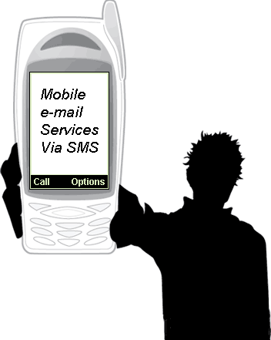
INTRODUCTION
E-mails have became part of our day-to-day life, in such scenario if we go to some place out of coverage where internet is not available, or may be power failure and we are suppose to send an e-mail urgently. There may be improvements in the technology have come in and we have
plenty of devices through which we can get connected
with the internet. But, having these all will alone not solve
this problem. To give a solution to this we are developing
application “MOBILE E-MAIL SERVICES VIA SMS”
In this , we can send an E-mail to any person through an
SMS.
4/11/2012

Slide 4
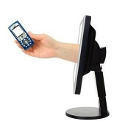
OBJECTIVES
Enabling users to deal with their e-mail with minimal technical knowledge with the help of SMS facility
Enhance mobile e-mail client with the features that gives the user, the possibility to fully control their e-mail’s, send e-mail’s from any mobile handset to any user which is having an e-mail account
To make the services of an e-mail client to become
available even on low cost mobile handsets which
otherwise is available only on a very few high end cell
phones
4/11/2012

Slide 5

SYSTEM ANALYSIS
EXISTING SYSTEM:
To send mail we need to have the internet facility available either in our systems or mobile devices. We have to connect to the internet and the specific mail provider website (Gmail/Yahoo/hotmail).
PROPOSED SYSTEM:
In the proposed system, Users need to register themselves
to our application with their mobile number, email ID and
password. Here no internet facility is required. Users are charged per SMS charges as per their tariff plan of SIM provider.
4/11/2012

Slide 6

OPERATIONS
USER:
Registers himself to the application.
Can send the messages through mobile phone to the intended
recipient.
SERVER:
Add new sender to the database.
Sends the text message as an E-mail to the particular
mail address.
Sends the error messages on any problem raised in
the communication.

Slide 7
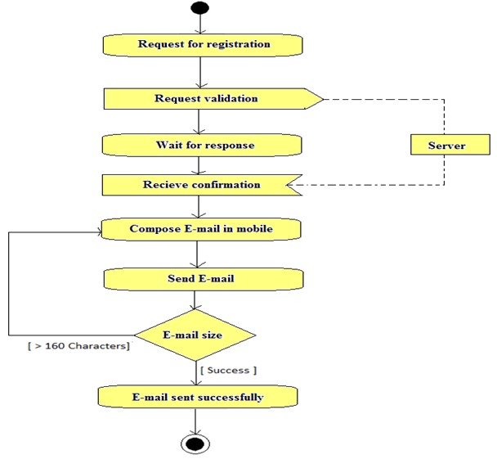
FUNCTIONAL DESIGN
4/11/2012

Slide 8

FEATURES
REGISTER TO THE APPLICATION:
Before using this application the sender should register to the application.
SEND E-MAIL:
After the registration, the sender can send the e-mail to any user via SMS services through his/her mobile.
RECEIVE E-MAIL:
Once the sender sends the e-mail, the intended receiver
receives the e-mail in his/her mailbox with the senders
e-mail id.

Slide 9
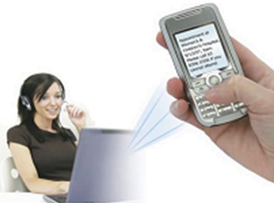
APPLICATIONS
This application is available not only on high end cell phones but also on low cost mobile handsets which provides the SMS facility
Allows fast and ease of sending E-mail from any remote location to any user
It saves the time of the sender by sending an E-mail in less time and in a reliable manner. Though the E-mail sent by the sender
is received by the intended recipient only , this
system provides a high security and privacy among
the users

Slide 10

LIMITATIONS
The user must have SMS enabled cell phone.
The mailing server should be active at all the time.
Any multimedia data cannot be sent through this system.
The Message size should be limited up to 160 characters.
4/11/2012

Slide 11

FUTURE SCOPE
In future, This application can be used when a single user want to send an e-mail to many users when internet connection is not available.
This application can be used in any cell phones providing SMS facility.
This application can be further implemented to send multimedia e-mails.
In future, we can develop this application to attach
any kind of multimedia file (Audio, Video, Image).

Slide 12

CONCLUSION
The main aim of this project is to make the services of an e-mail client to become available even on low cost mobile handsets which otherwise is available only on a very few high end cell phones
Any user can send an e-mail to other user from his/her mobile phone soon after registering to the application
This application provides more security
This service is available for free of cost
4/11/2012

Slide 13

REFRENCES
http://www.sms-integration.com
www.mobiforge.com/developing/story/email-configuration-sms
www.vodacommessaging.co.za/smsmail.asp
www.csharp-station.com
www.sqlteam.com

Slide 14
Thank you…

Slide 15

Any queries

